Slide 1


E-commerce segmentation and recommender system
GITHUB REPOSITORY:
https://github.com/nicovy/ecommerce
Nicolas Veas
Notes:
Supervised Learning Final Project

Slide 2
Objective
Context
Understanding the audience of an e-commerce platform is crucial for effective marketing, as it enables the use of personalized strategies.
Developing a customer segmentation model allows us to understand the different profiles and preferences of the e-commerce customers.
This enhances customer engagement and supports implementing a recommender system that could help improve the shopping experience by providing personalized suggestions that a specific customer will likely purchase.
In this project, I'll use unsupervised learning models to build a customer segmentation and a recommender system.
The data used is from kaggle from the following link:
https://www.kaggle.com/datasets/shrishtimanja/ecommerce-dataset-for-data-analysis
- To segment customers into distinct groups
- To build a recommender system that recommend products to customers

Slide 3
Data Information
55000 Observations
13 Variables
4 Numerical Variables
8 Categorical Variables
Discount name have missing values
No duplicated Values
Contains the following Variables
CID (Customer ID): A unique identifier for each customer.
TID (Transaction ID): A unique identifier for each transaction.
Gender: The gender of the customer, categorized as Male or Female.
Age Group: Age group of the customer, divided into several ranges.
Purchase Date: The timestamp of when the transaction took place.
Product Category: The category of the product purchased, such as Electronics, Apparel, etc.
Discount Availed: Indicates whether the customer availed any discount (Yes/No).
Discount Name: Name of the discount applied (e.g., FESTIVE50).
Discount Amount (INR): The amount of discount availed by the customer.
Gross Amount: The total amount before applying any discount.
Net Amount: The final amount after applying the discount.
Purchase Method: The payment method used (e.g., Credit Card, Debit Card, etc.).
Location: The city where the purchase took place.

Slide 4
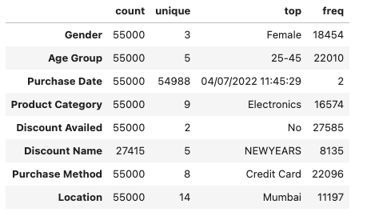
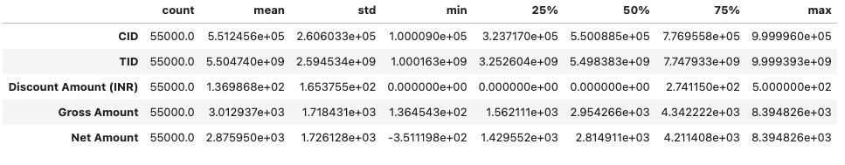
Data Overview
Mean discount of 136.986796 vs median of 0, which suggests the data is right-skewed
Gross Amount and Net Amount are also skewed to the right
There are negatives in Net Amount, which probably was mistyped
The data contains 29071 unique customers with a maximum of 8 purchases per customer
Gender is divided into 3 categories and majority of females
Most customers are in the age group of 25-45 y/o
Electronics is the top category among 9 categories
50.15% of the purchases were made without discount
Credit card was the preferred purchase method among 8 different methods
Purchases were made from 14 different locations, all locations are in India

Slide 5
Data Cleaning & Transformation
Corrected Data types
Handled missing values
Missing discount name replaced by 0
Cleaned duplicates
Adjusted negative net values
Replaced negatives by 0
Adjusted discount amounts
It shouldn’t be more than the gross amount
Set purchases to 2 decimals

Slide 6
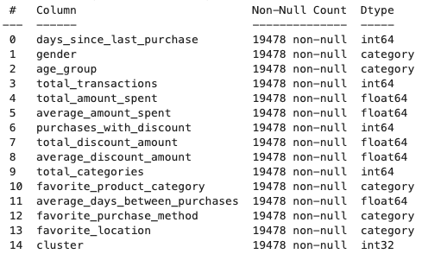
Feature Engineering
For clustering purposes, we created a table in the following way
CID: id of the customer
gender: customer gender
age_group: customer age group
days_since_last_purchase: the number of days since last purchase
total_transactions: the total number of transactions
total_spent: the total amount spent in all transactions
avg_spent: the average spent per transaction
purchases_with_discount: The number of purchases with discount
total_discount: the total discounts in all transactions
avg_discount: the average discount per transaction
product_categories: count of unique purchased categories
favorite_product_category: favorite product category for each customer
avg_days_between_purchases: the average days between purchases
purchase_method: favorite purchase method for each customer
purchase_location: favorite purchase location

Slide 7
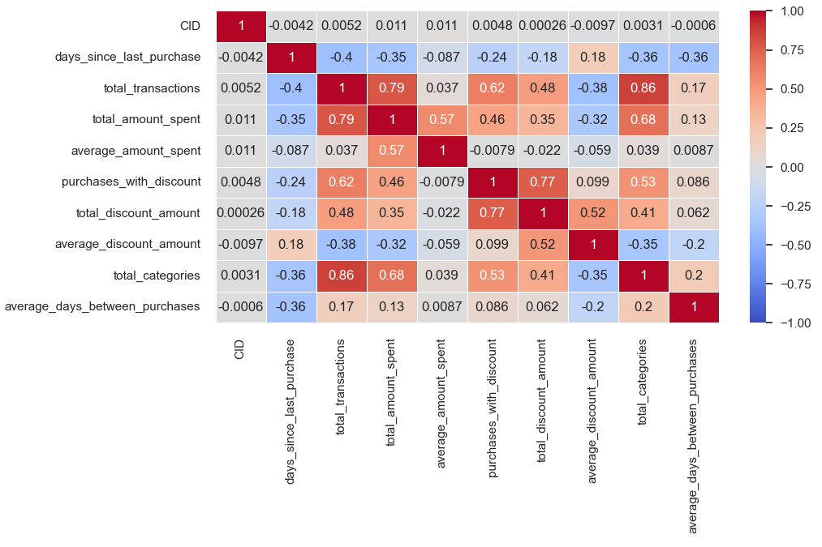
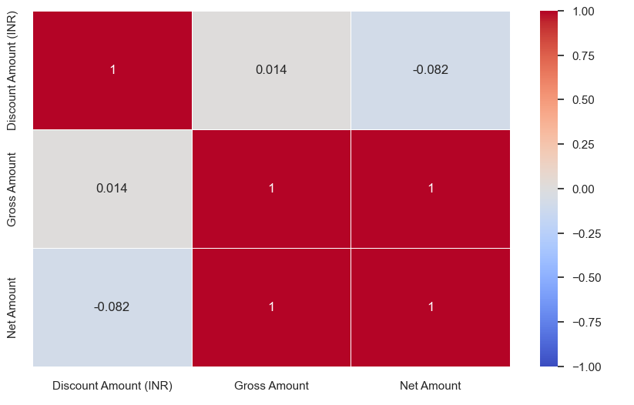
Exploratory data analysis Correlation heatmap
Total categories are highly correlated with total transactions, which means that usually, customers shop from different categories
Total transactions are highly correlated with the total amount spent
Average discount and total discount are also highly correlated
The total amount spent and total categories are highly correlated
Gross and net are highly correlated as expected
Discount is very low correlated to gross and net amounts

Slide 8
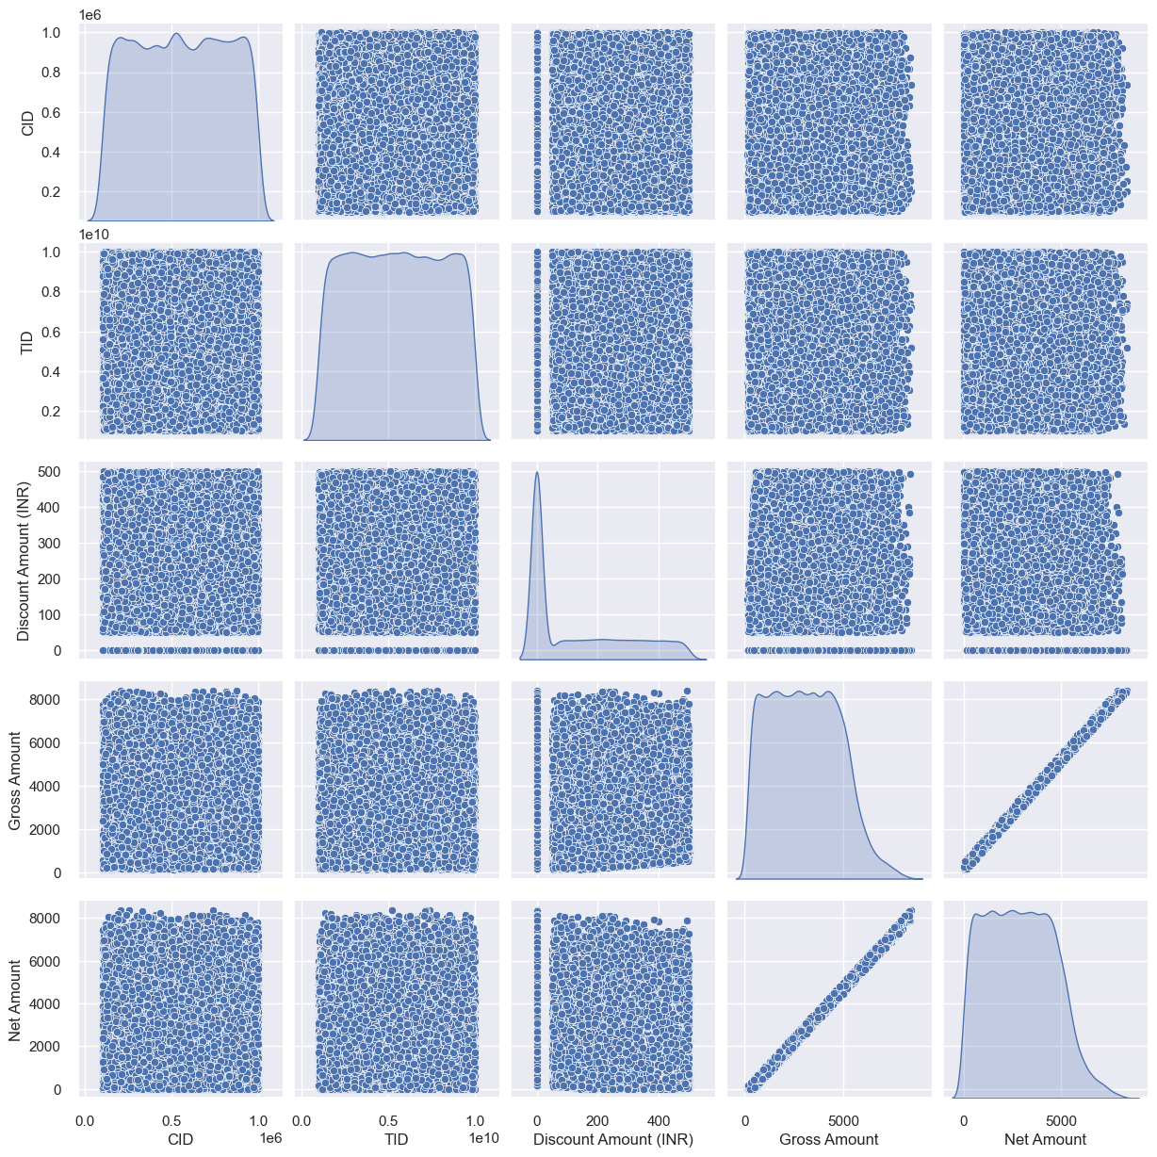
Exploratory data analysis Scatter plot
Gross and Net amounts are highly correlated with a linear relationship
For discount amount, we can identify 2 different groups, purchases with 0 discount and purchases with discount.

Slide 9
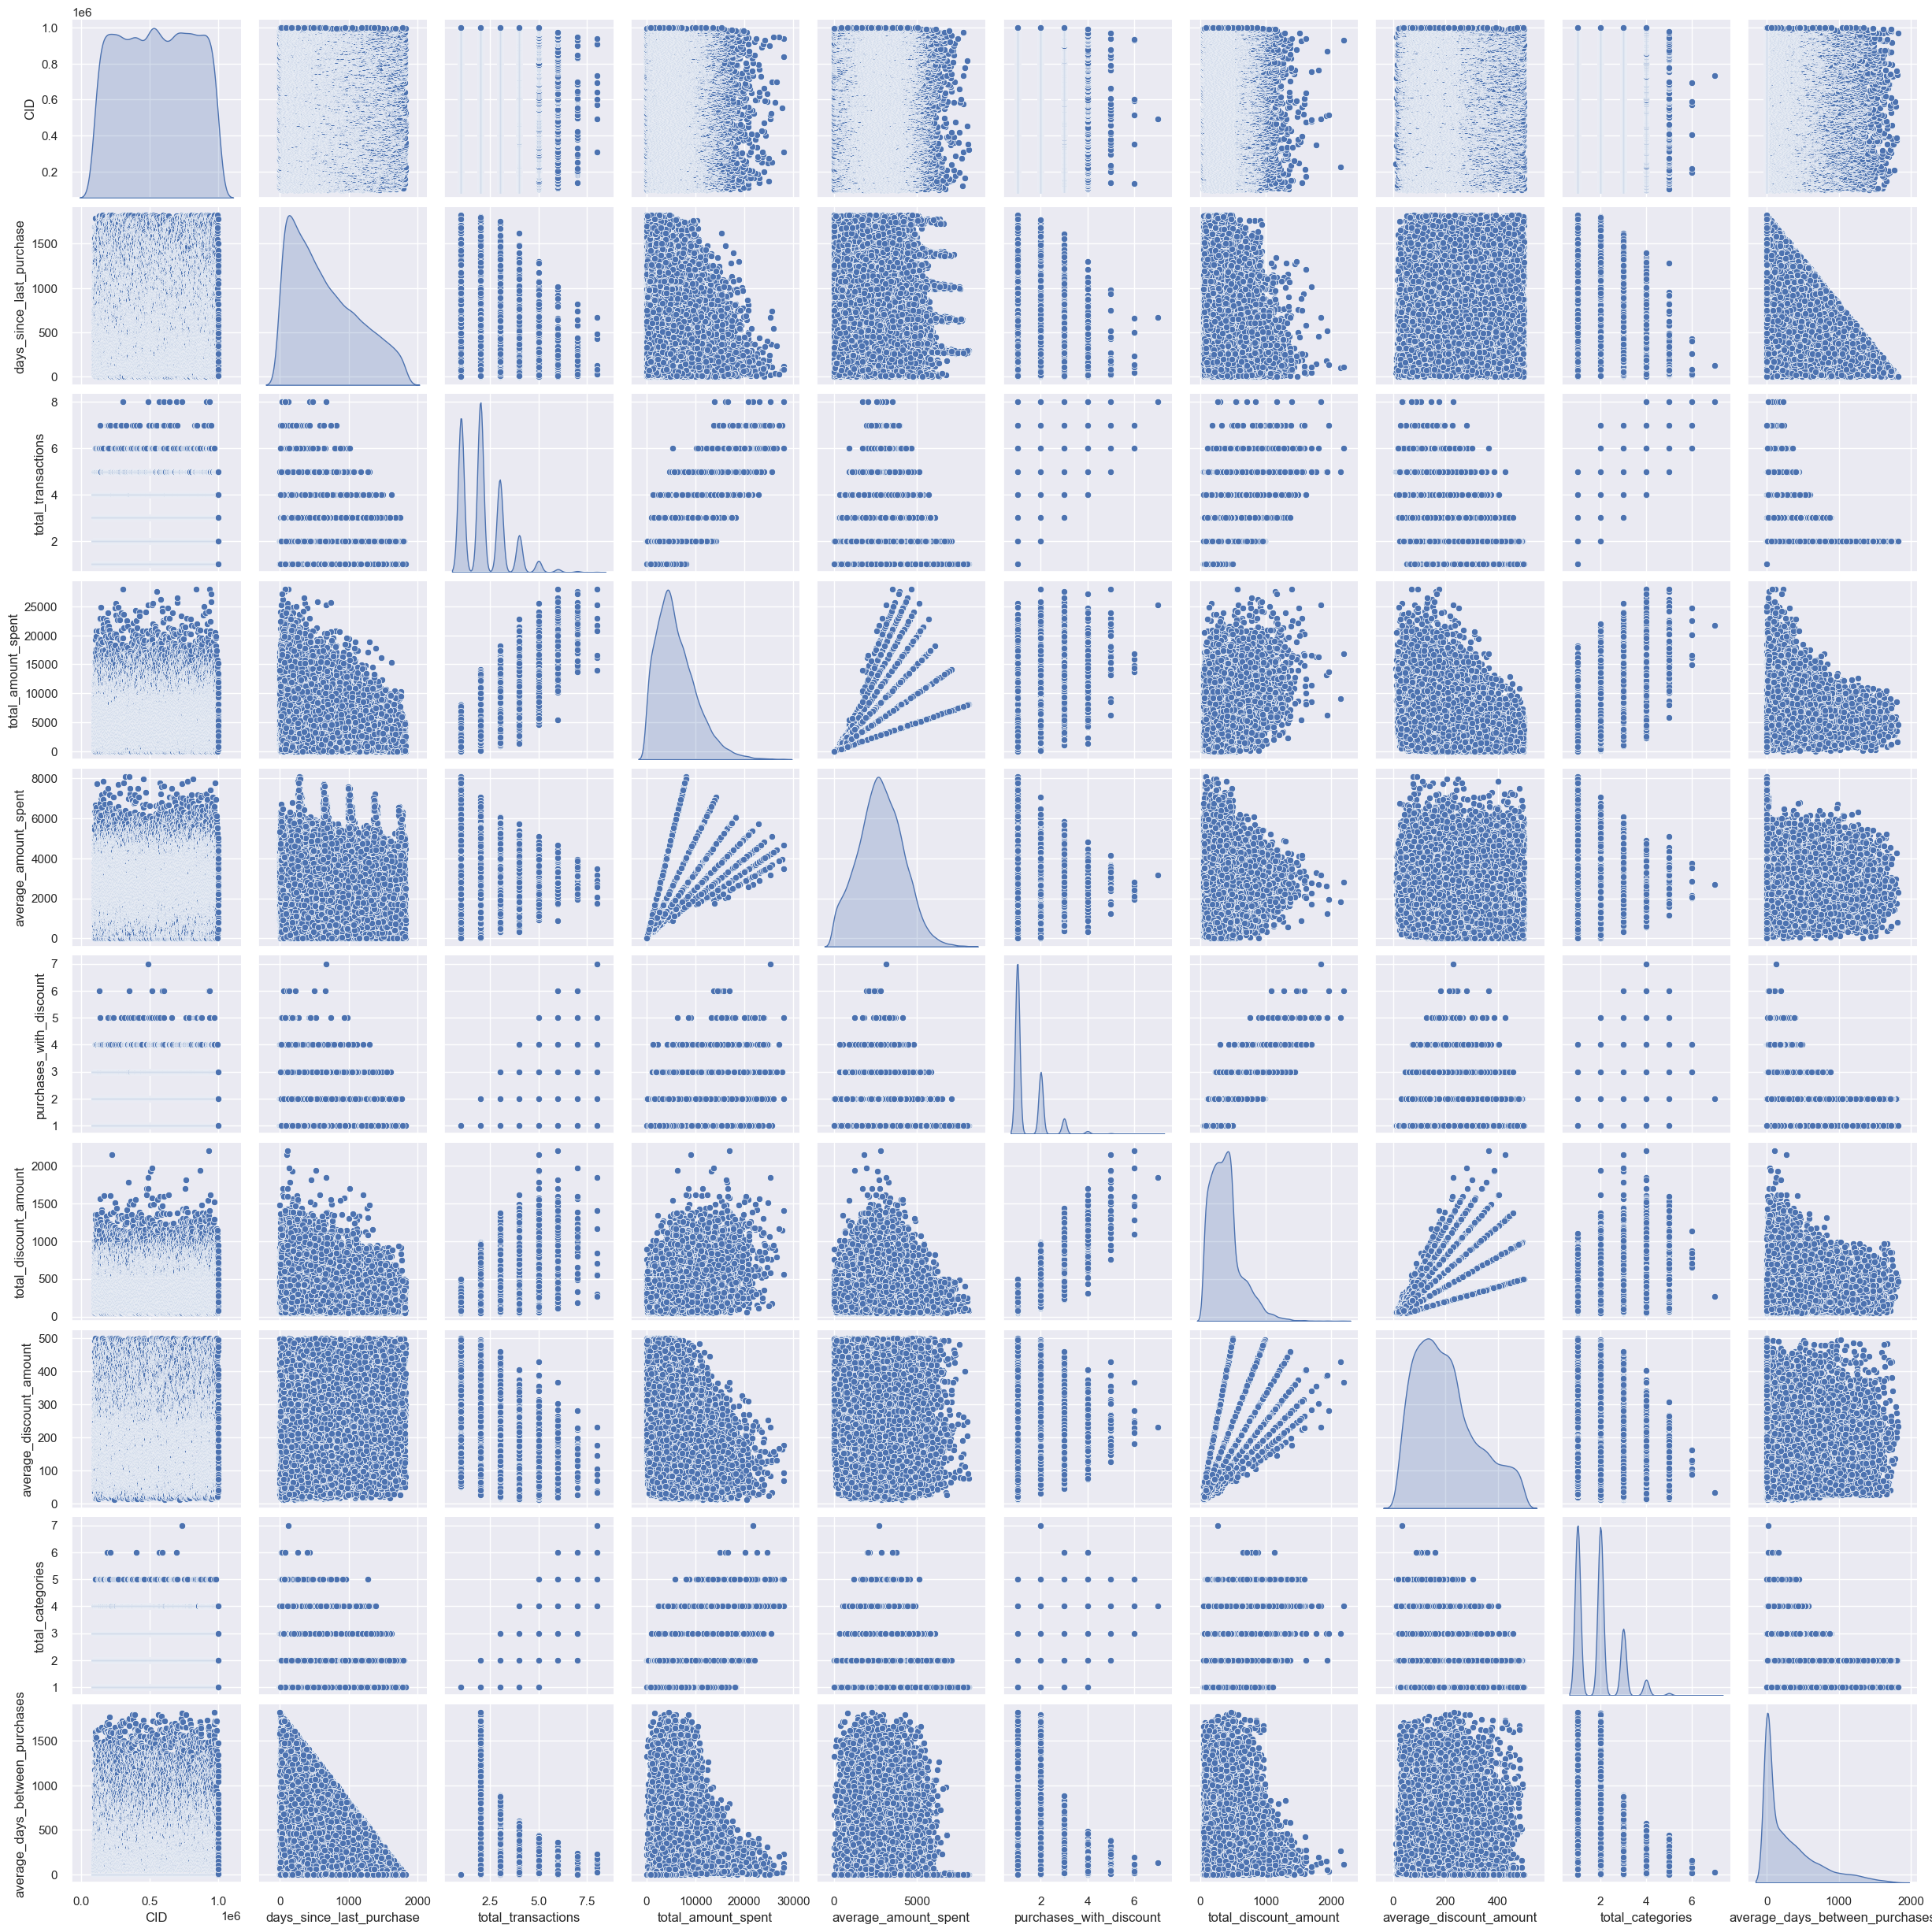
Exploratory data analysis Scatter plot
People with more transactions tend to buy more often
We can appreciate linear relation between total_amount and average_amount, and between total_discount and average_discount

Slide 10
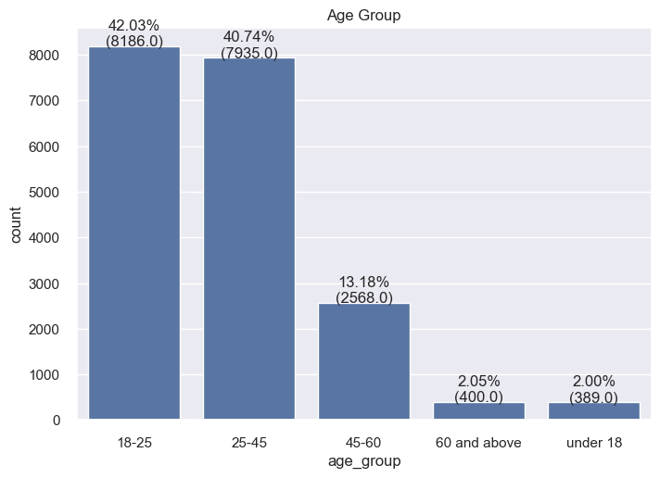
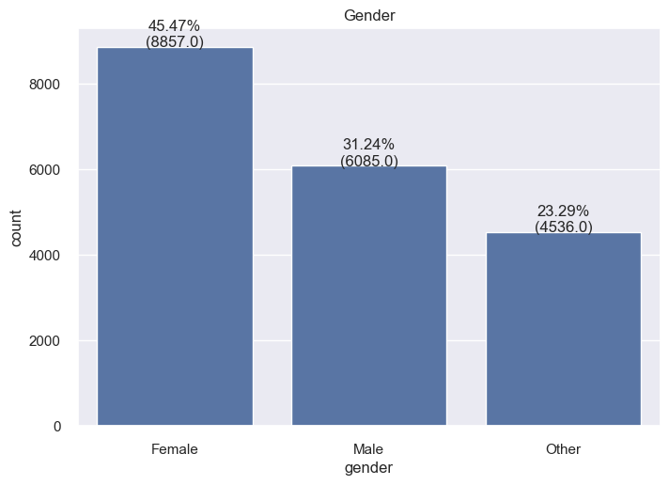
Exploratory data analysis Categorical
Most of the customers are female
~ 80% of customers in ages between 18-45
Very few customers in ages above 60 and under 18

Slide 11
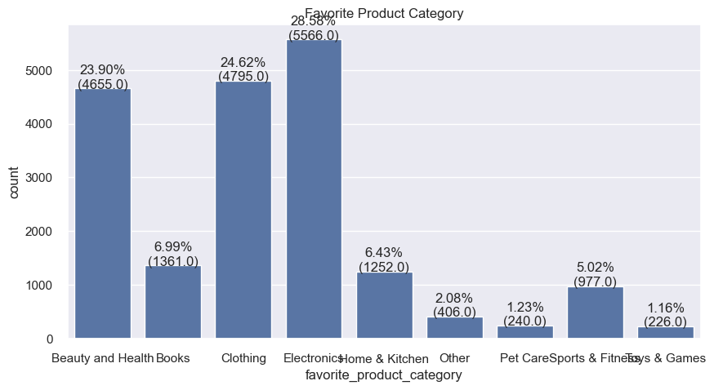
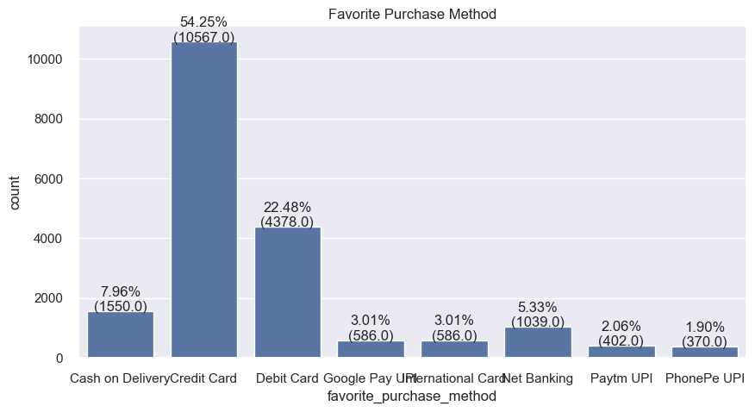
Exploratory data analysis Categorical
The most popular categories are Electronics, Clothing, and Beauty and Health (~ 75%)
Pet care and toys & Games have a very few amount
Most of the payments are made using credit cards (~74%)
The second most popular payment method is debit card

Slide 12
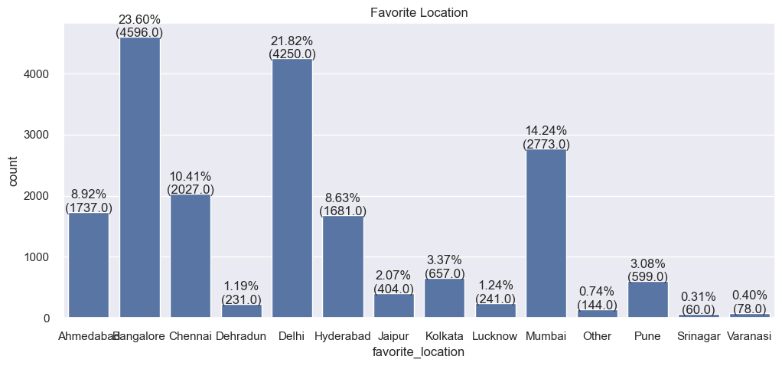
Exploratory data analysis Categorical
Of the 29071 customers, ~ 57% are from Bangalore, Delhi, and Mumbai
Dehradun, Srinagar, Varanasi, and Other have under 1% of customers each

Slide 13
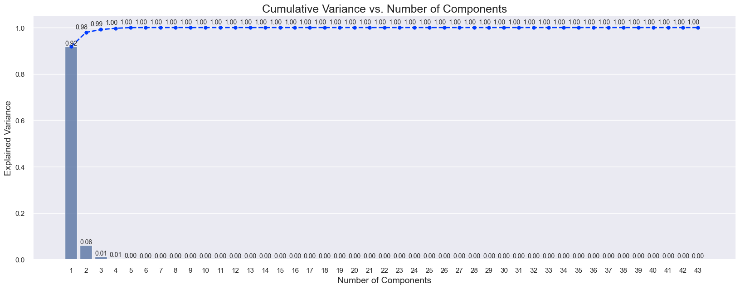
Data Preparation
One Hot encode
43 features
PCA
We chose 3 as the number of components, as this explains .99 of the variance

Slide 14
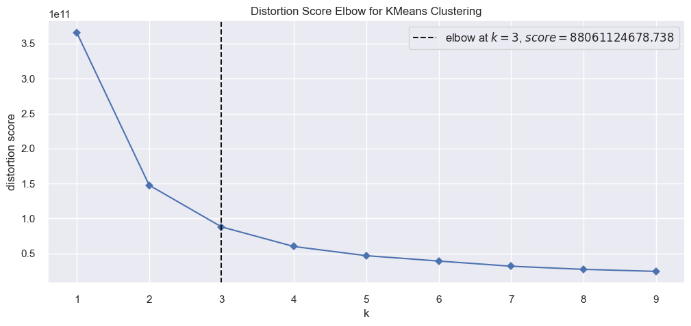
K-Means Modeling Determine Number of Clusters
Using elbow method
Suggest an optimal number of clusters of 3

Slide 15
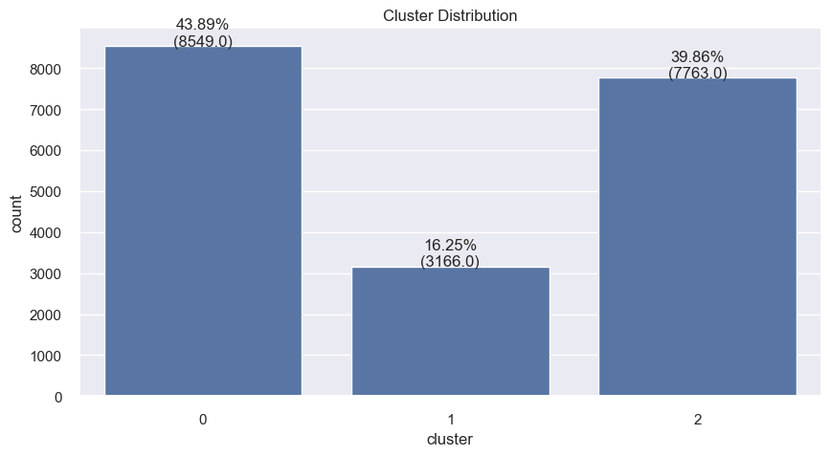
K-Means Modeling Clustering model
Clusters 0 and 2 have a balanced amount of customers
Cluster 1 has the least customers (4638)

Slide 16
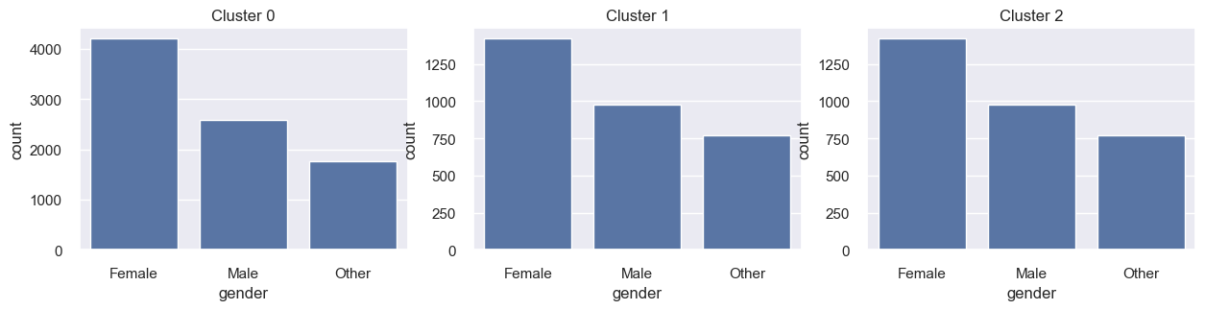
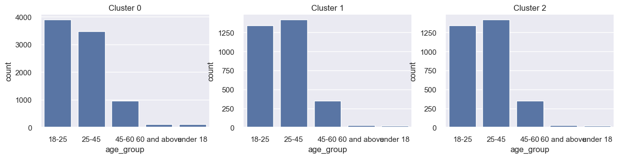
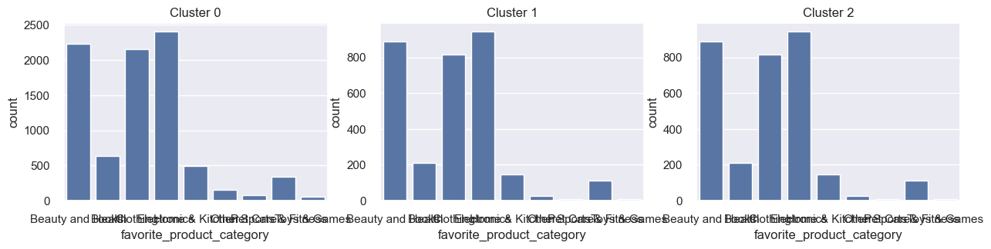
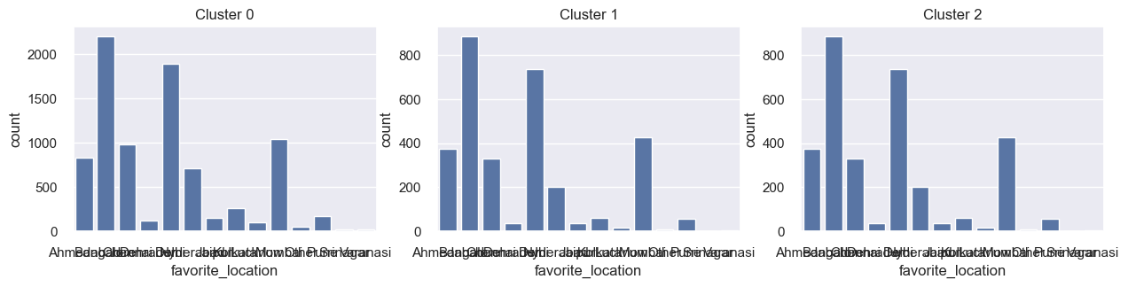
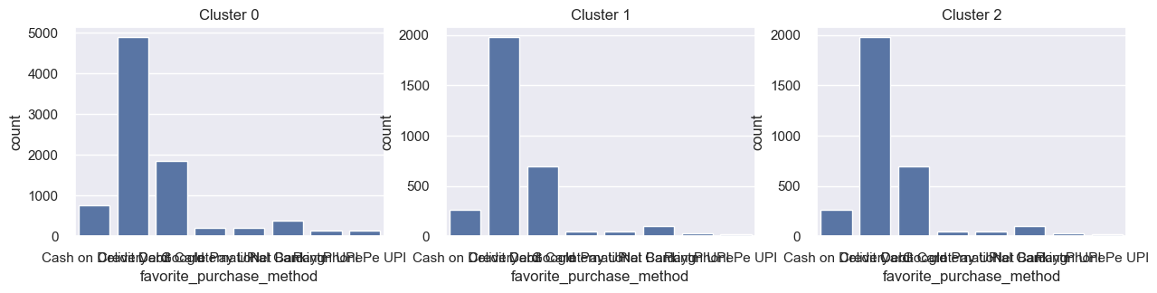
K-Means Modeling Clustering model
The 3 clusters have similar distribution for gender, age group, favorite product category, favorite purchase method, and purchase location.

Slide 17
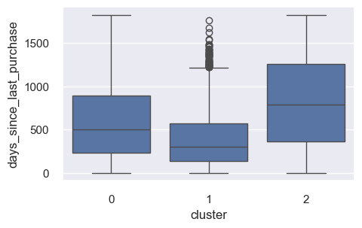
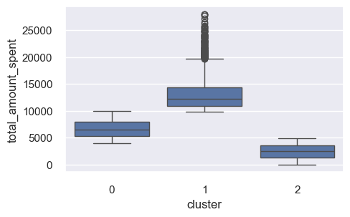
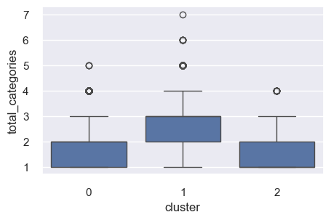
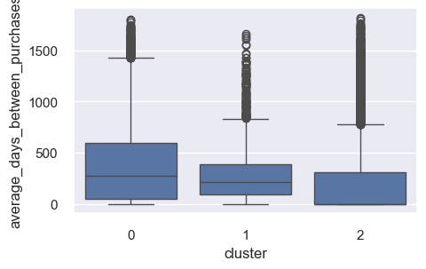
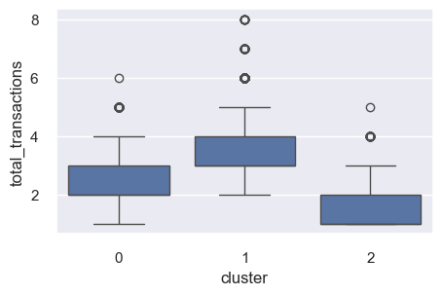
K-Means Modeling Cluster Descriptions
Cluster 0 - Casual buyers:
Customers that buys more than once
All age ranges
Total spend between 4000 and 9000
They spend between 2500 to 5000 per purchase
days between purchases is under 1000 days
Cluster 2 - One-time buyers:
Customers that are one or two-time buyers.
All age ranges
buy items from all of the categories
Spend under 4000 in total
Spend under 3500 per purchase
Buys with the highest discount amount
Buys from one or two product categories
Cluster 1 - Recurrent buyers:
Customers with many purchases
Age range from 18 to 60 years old
They have a total spend of over 10000
Most of the purchases are with a discount
They spend between 2500 to 5000 per purchase
The time between purchases is under 500 days

Slide 18
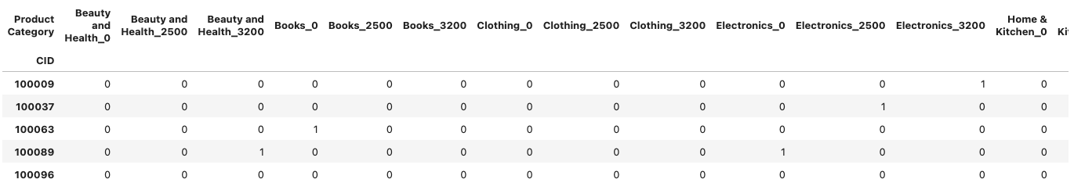
Recommender System
Used matrix factorization
Matrix preparation:
Given that the amount spent was the most differentiated in the clustering, we will create the matrix in the following order
p_cat_1_0 -> count of purchases was more than 0 but less than 2500
p_cat_1_2500 -> count of purchases was more than 2500 but less than 3200
p_cat_1_3200 -> count of purchases was more than 3200
In this way, our recommender system can recommend a category and a price range from that category

Slide 19
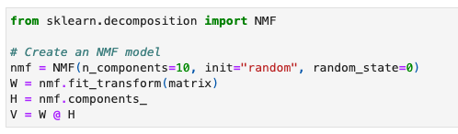
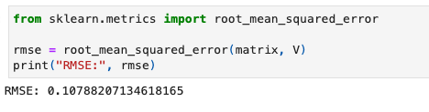
Recommender System
Started with 10 components
Root mean square error : 0.1079

Slide 20
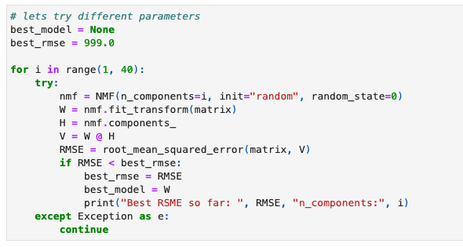
Recommender System
Finding the best parameters
34 is the optimal for n_components
Giving a RMSE of 0.0000503

Slide 21
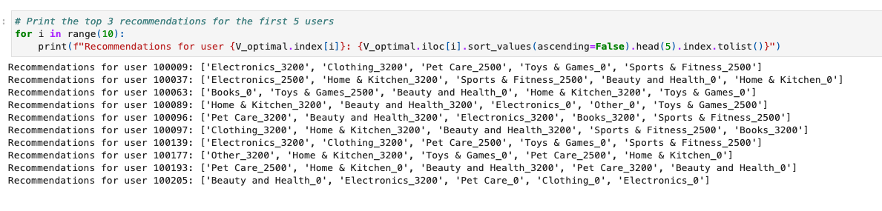
Recommender System - Testing
We can appreciate the top 5 recommendations for the first 10 users.
the _0, _2500, and _3200 represent the price range that the user is likely to purchase
When a user logs in to the e-commerce platform we can check this matrix and recommend to the user products in these categories and in the price range.

Slide 22
Conclusions
We analyzed the data of an e-commerce platform with 55000 entries (purchases)
We treated missing values, wrong data types, negative values, and adjusted discounts for proper data analysis and modeling
We had to transform the data before implementing any model to get meaningful insight into each segment
We implemented unsupervised models for an e-commerce platform
We implemented k-means for clustering and identified 3 different segments of users with different preferences and behaviors
one-time buyers
casual buyers
recurrent buyers
We used Non-Negative Matrix Factorization to implement a recommender system that is able to suggest the top categories for each user and the price range that they are likely to purchase.

